Slide 1
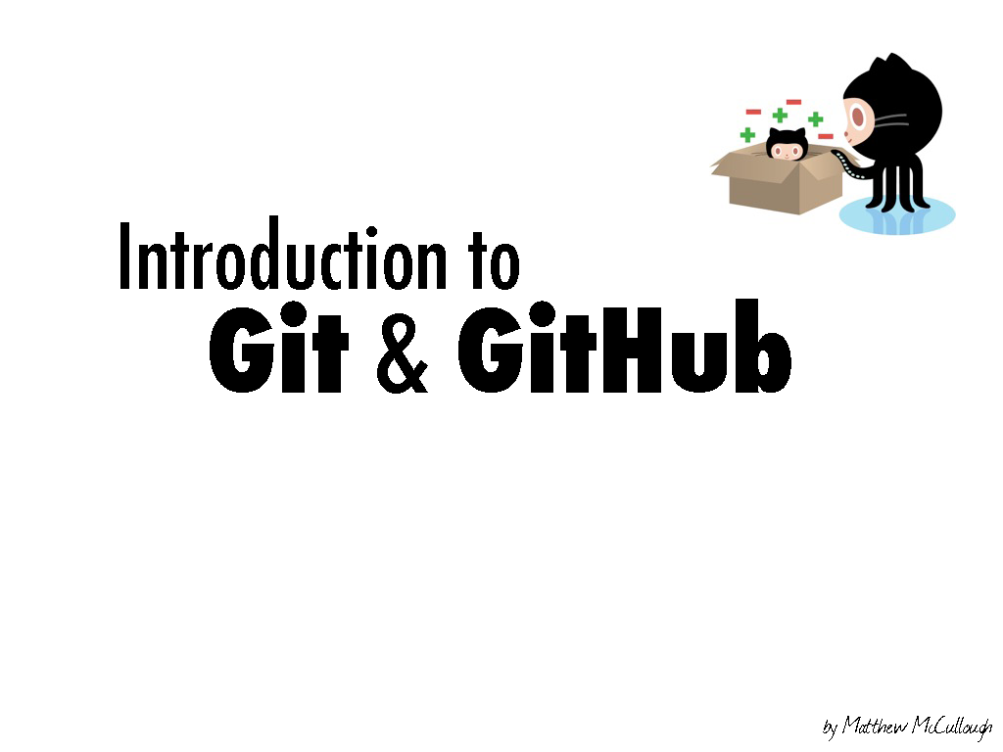
@pantaovay
@We Are SA!

Slide 2
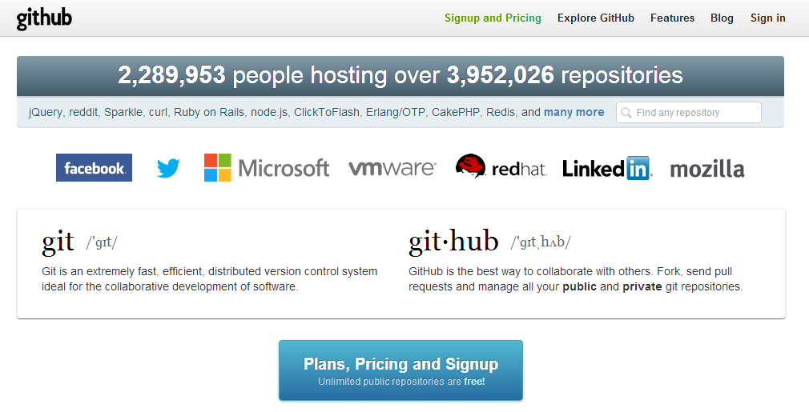

Slide 4
a brief introduction of
Git

Slide 5


Slide 6
In software development, Git is a distributed revision control and source code management system with an emphasis on speed.
-- From Wikipedia

Slide 7
In software development, Git is a distributed revision control and source code management system with an emphasis on speed.
-- From Wikipedia

Slide 8
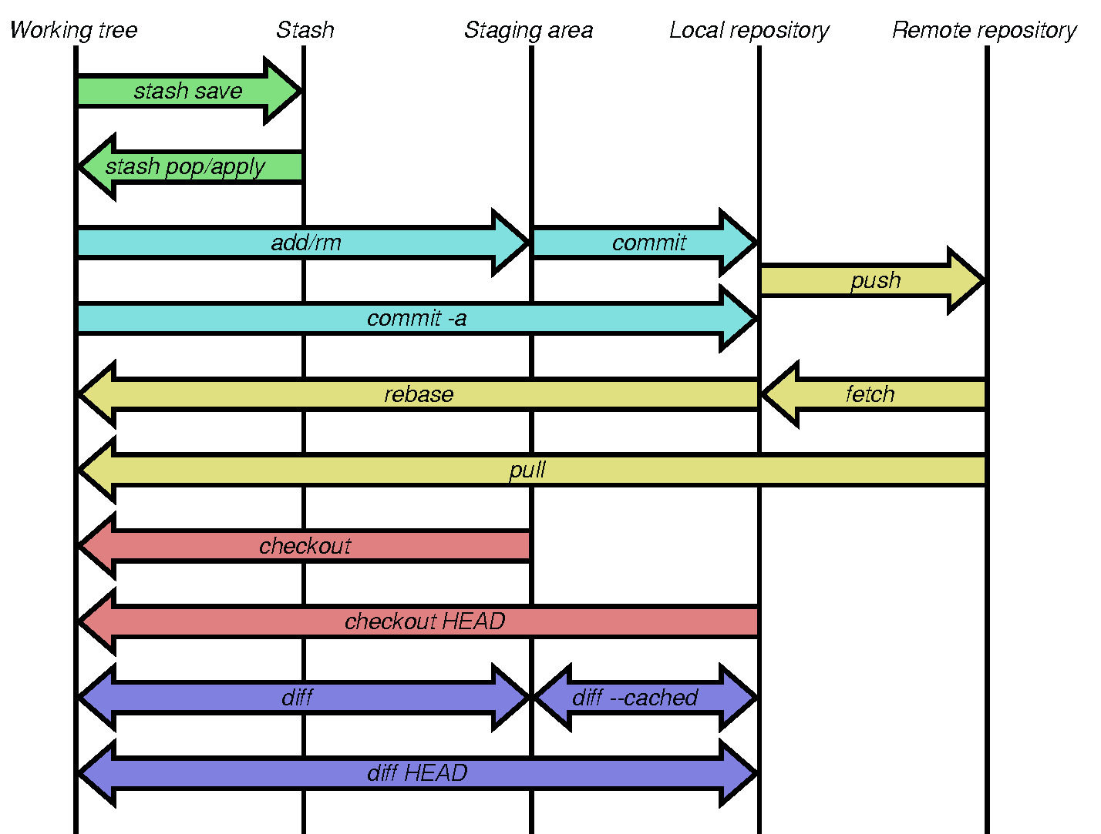
-- From dev:git-commands.svg

Slide 9
-- From dev:git-commands.svg

Slide 10
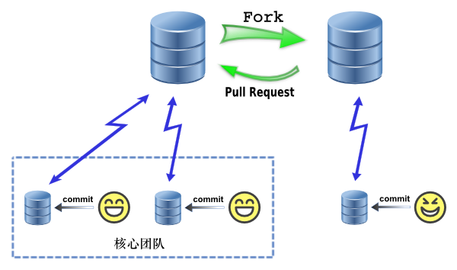
Core Team
Free Coder
-- From GotGitHub

Slide 11
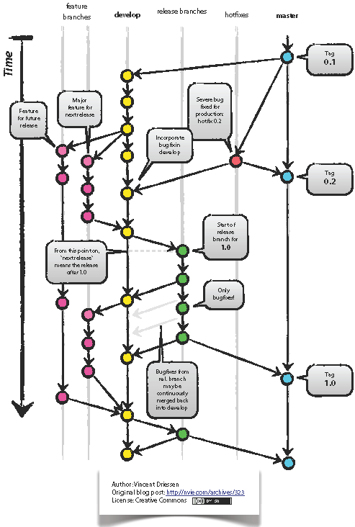
-- A successful Git branching model

Slide 12


Slide 13
GitHub
a RIA for Git

Slide 14
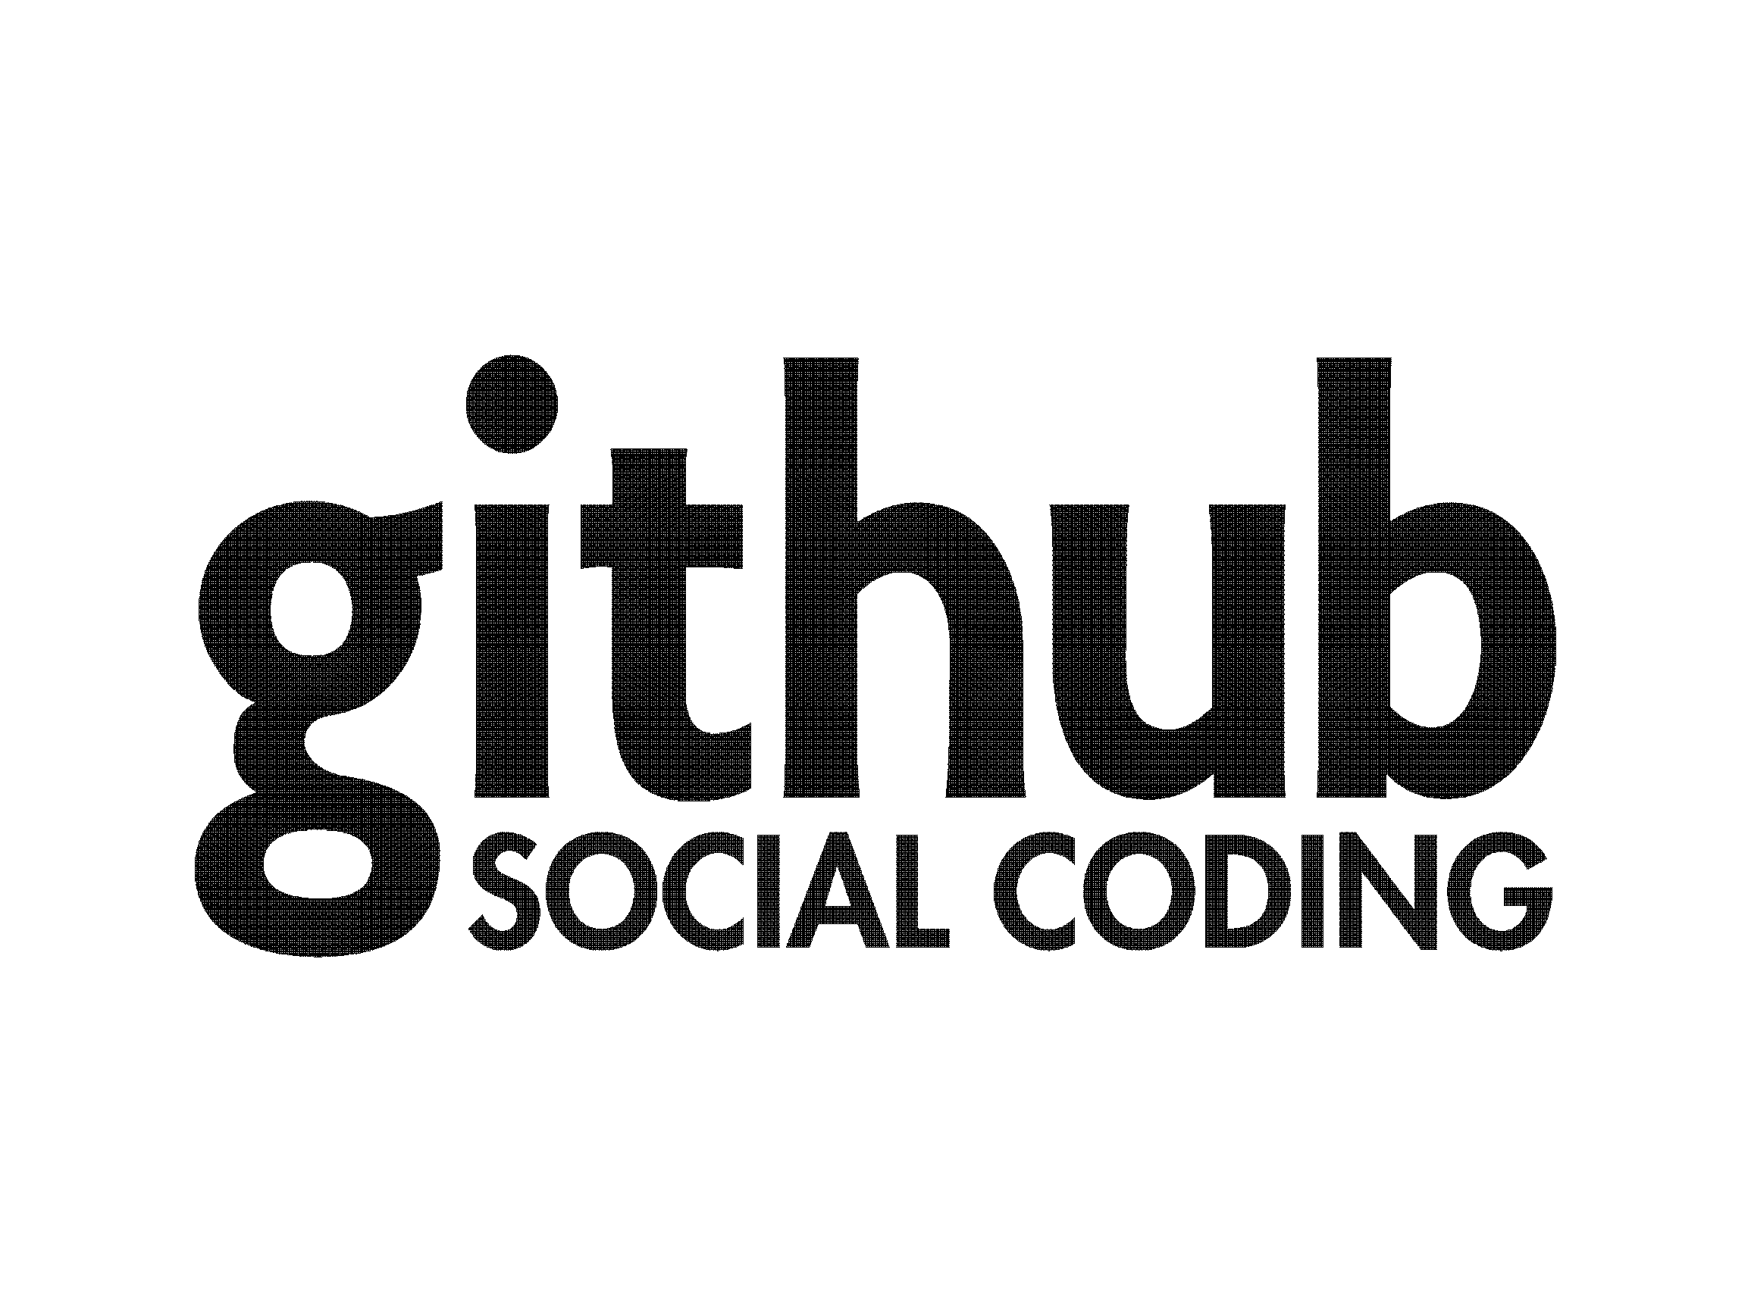

Slide 15


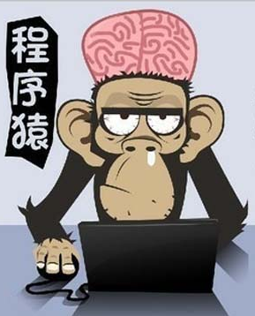
Facebook for Programmers
CODER

Slide 16
Based On Git
Beyond Git

Slide 17
Based On Git
Beyond Git
Ruby on Rails/HTML5
In-browser syntax highlighted code editing
Gist: Code snippets
GitHub Pages
Speaker Deck: Presentations
Graphs
Conversations on code changes

Slide 18
Based On Git
Beyond Git
Ruby on Rails/HTML5
In-browser syntax highlighted code editing
Gist: Code snippets
GitHub Pages
Speaker Deck: Presentations
Graphs
Conversations on code changes

Slide 19




T
oyhouse
Social Learning

Slide 20
Beyond GitHub
But We Should Learn From GitHub Now

Slide 21
Workflow
level and privilege

Slide 22
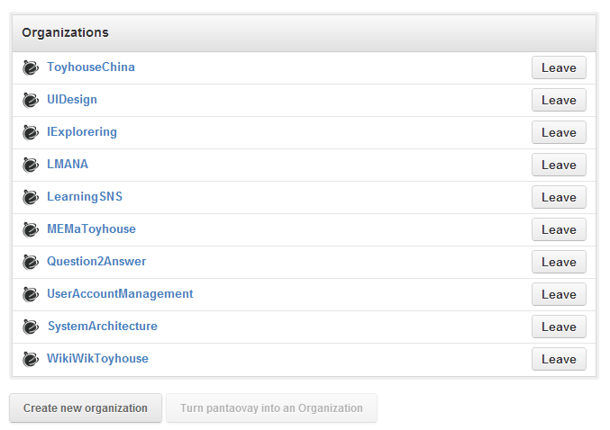

Slide 23
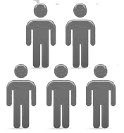



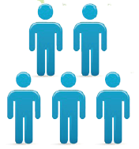

ToyhouseChina
MERGE
PULL REQUEST
FORK
FORK
FORK
FETCH or PULL
PUSH
PUSH
PUSH
LOCAL COMMIT

Slide 24

GitHub is productivity!
Just learn by playing with it!

Slide 25
Thanks!

